Slide 2
Families First Coronavirus
Response Act – Important
Information for Employers
Leonard J. Dietzen, III
and Kayla E. Platt Rady
NEFEC
March 24, 2020

Slide 3
Families First Coronavirus Response Act
President Trump signed this bill on March 18, 2020. Its provisions will go into effect on April 2, 2020, and expire December 31, 2020. The act provides paid sick leave for employees impacted by COVID-19 and those serving as caregivers for individuals with COVID-19 through
An emergency expansion of the FMLA
A new federal paid sick leave law.
© 2020 Rumberger, Kirk & Caldwell, P.A.

Slide 4
Division C: Emergency FMLA Expansion

Slide 5
Definitions
Eligible employee - employed at least 30 calendar days
Private employer - amended to “fewer than 500 employees” (no longer 50 or more)
Public employer – applies regardless of number of employees
Public heath emergency – an emergency with respect to COVID-19 declared by a federal, state, or local authority
© 2020 Rumberger, Kirk & Caldwell, P.A.

Slide 6
Definitions
Qualified Need – Employee is unable to work (or telework) due to a need for leave to care for his or her child who is under 18 years of age because:
the child’s elementary or secondary school or place of care has been closed due to a public health emergency; or
the child care provider of such child is unavailable due to a public health emergency.
© 2020 Rumberger, Kirk & Caldwell, P.A.

Slide 7
How Leave Is Apportioned
First 10 days – unpaid leave (employee can use vacation, PTO, sick/medical leave but employer cannot force employee to use)
Next ten weeks – employer must pay
© 2020 Rumberger, Kirk & Caldwell, P.A.

Slide 8
Paid Leave
No less than 2/3 regular rate of pay and number of hours normally scheduled to work
Not to exceed $200 / day or $10,000 aggregate
Varied hours - average number of hours/day
  6-month period ending on date employee takes leave
  include leave hours of any type
© 2020 Rumberger, Kirk & Caldwell, P.A.

Slide 9
Division E: Emergency Paid Sick Leave Act

Slide 10
Eligible Employee
Employer shall provide to each employee paid sick time to the extent the employee is unable to work (or telework) due to a need for leave because:
Employee is subject to federal, state or local quarantine / isolation order related to COVID-19;
Employee has been advised by a health care provider to self-quarantine due to concerns related to COVID-19;
Employee is experiencing symptoms of COVID-19 and seeking a medical diagnosis;
© 2020 Rumberger, Kirk & Caldwell, P.A.

Slide 11
Eligible Employee
Employer shall provide to each employee paid sick time to the extent the employee is unable to work (or telework) due to a need for leave because:
Employee is caring for an individual who is subject to an order as described in (1) or has been advised as described in (2);
Employee is caring for his or her child if school or place of care of the child has been closed or child care provider of such child is unavailable due to COVID-19 precautions;
© 2020 Rumberger, Kirk & Caldwell, P.A.

Slide 12
Eligible Employee
Employer shall provide to each employee paid sick time to the extent the employee is unable to work (or telework) due to a need for leave because:
Employee is experiencing substantially similar condition (to those described above), as specified by the Secretary of Health and Human Services in consultation with Treasury and Labor.
Note: The employee only has to meet the foregoing elements to be eligible. It does not matter how long he or she has been employed.
© 2020 Rumberger, Kirk & Caldwell, P.A.

Slide 13
Which Employers Must Comply?
Private – those who employ fewer than 500 employees
Public – those who employ one or more employees
© 2020 Rumberger, Kirk & Caldwell, P.A.

Slide 14
Duration of Paid Sick Leave?
Full-time employees – 80 hours
Part time employees – number of hours worked on average over a two-week period
© 2020 Rumberger, Kirk & Caldwell, P.A.

Slide 15
Amount of Pay?
For employees who qualify under 1, 2 or 3
Number of hours normally scheduled or number of hours calculated based on two-week period and regular rate of pay
Capped at $511 per day or $5,110 aggregate
The Secretary of Labor will issue guidelines to assist employers in calculating amount paid sick leave within 15 days.
© 2020 Rumberger, Kirk & Caldwell, P.A.

Slide 16
Amount of Pay?
For employees who qualify under 4, 5 or 6
2/3 amount of regular rate of pay
Capped at $200 per day or $2,000 aggregate
The Secretary of Labor will issue guidelines to assist employers in calculating amount paid sick leave within 15 days.
© 2020 Rumberger, Kirk & Caldwell, P.A.

Slide 17
Varied Hours?
If hours vary from week to week: use average number of hours employee scheduled per day over 6-month period ending on date which employee takes paid sick time, include hours for which employee took leave of any type.
If employee did not work over such period, the reasonable expectation of the employee at the time of hiring of the average number of hours per day that employee would normally be scheduled to work.
© 2020 Rumberger, Kirk & Caldwell, P.A.

Slide 18
Other Requirements
Available immediately regardless how long employee been employed
Cannot require employee to use other paid leave before use paid sick leave
Terminates after need terminates
Cannot carry over into next year
Cannot discharge/discipline employee for use of paid sick leave
Information must be posted in conspicuous place on premises
© 2020 Rumberger, Kirk & Caldwell, P.A.

Slide 19
The information provided during this presentation is not intended for legal advice. The presentation, and any handouts which may accompany it, provide general information on this topic and answers to common questions about this issue. Please consult an attorney to assure that this information, and your interpretation of it, are appropriate to your particular situation.
© 2020 Rumberger, Kirk & Caldwell, P.A.

Slide 20
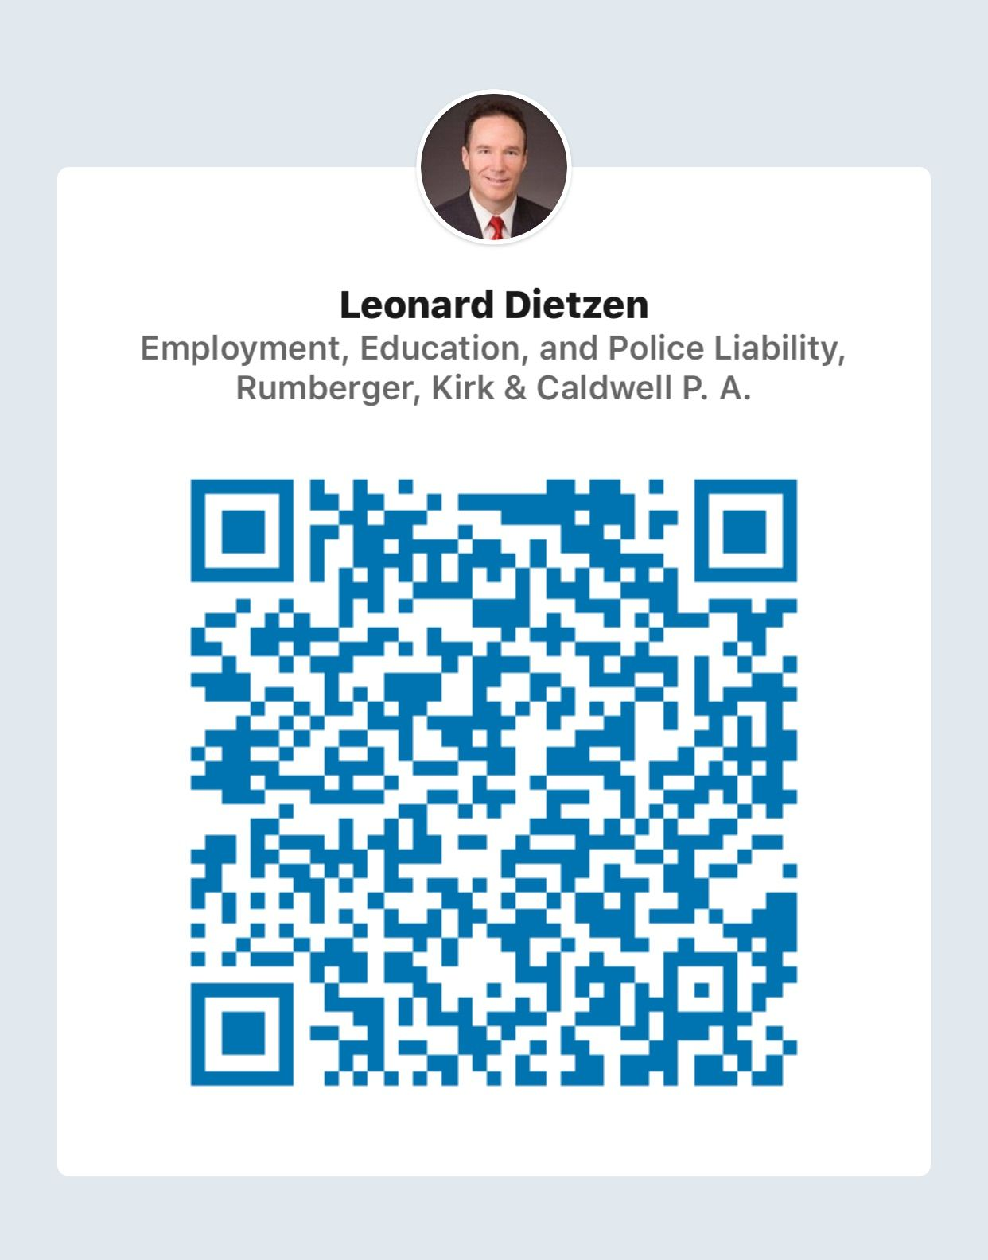
Thank you!
Leonard J. Dietzen, III
RumbergerKirk
101 North Monroe Street
Suite 120
Tallahassee, FL 32301
(850) 222-6550
ldiezten@rumberger.com
© 2020 Rumberger, Kirk & Caldwell, P.A.

